Slide 1
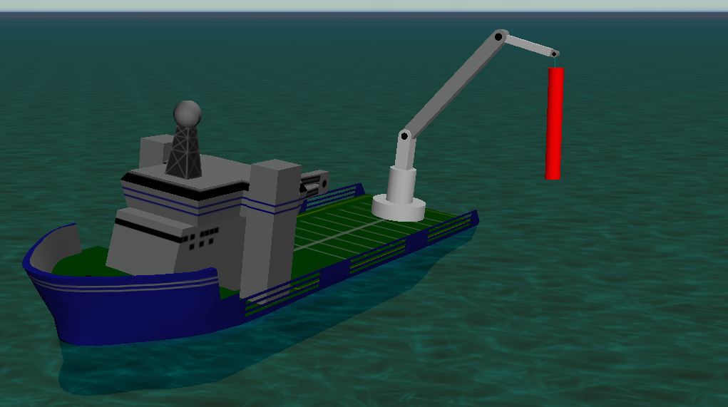
Floating Offshore Energy Systems
Experimental and numerical investigations on wind
and wave energy
Floating offshore energy systems will play an important role in the energy transition from fossil to renewable energy sources. While most wave energy converter (WEC) concepts are still in the development phase and only few of them reach commercialization, floating wind turbines are already deployed in Japan, Great Britain, Norway, and further countries. Both technologies unite the needs for further research and development in various areas, e.g., structural and geometric optimization, efficient mooring solutions, and offshore logistics (transport, installation, maintenance).
Even for bottom-fixed offshore wind turbines, which are growing in height and being installed in larger water depths, innovative installation methods like floating installation (e.g., wind farm Arcadis Ost close to Rügen) need to be developed.
Hence, floating offshore energy is a growing field, and Ludwig-Franzius-Institute of LUH is investigating many different aspects of it. Both, experimental studies in the various facilities (wave flumes, wave-current basin) and numerical studies with models of different fidelities (from high-fidelity CFD simulations in OpenFOAM to engineering models like OrcaFlex) have been conducted in the past and will be conducted in future research projects, which offer various areas of collaboration.
Recent studies
Mooring optimization for an array of floating point absorber wave energy converters
Experimental investigation of the influence of different mooring systems on motion and efficiency of the WEC
Numerical studies on the validity of engineering models and the simulation of realistic power take off (PTO) systems
Safety improvements for offshore operations
Experimental study on the motion response of off-shore work vessels in regular and irregular sea states
Development of a simulation model to predict the occurrence of sea sickness during transit
Numerical studies on the limiting factors during the transit from vessel to (floating) offshore wind turbine
Experimental and numerical investigations on excissive motions of crane loads during floating crane operations
Motion response study for a floating wind energy tur-bine in waves
Response determination in regular waves in the wave flume
Validation of a CFD model (OpenFOAM)
OrcaFlex simulation of an offshore crane operation
Model test setup in 3D wave-current basin
Ludwig-Franzius-Institut
für Wasserbau, Ästuar und Küsteningenieurwesen
Prof. Dr.-Ing. habil. Torsten Schlurmann
Jun.-Prof. Dr.-Ing. Arndt Hildebrandt; Jannik Meyer, M.Sc.
www. lufi.uni-hannover.de
Projects: SFB1463 – Offshore Megastructures (DFG),
Active Vessels in Motion – AVIMo (BMWK),
OpenRAVE (BMWK), MooringSP (Industrie)

